Slide 1
Unit 4
Tools and methods used in cybercrime

Slide 2
Agenda
Password Cracking
Keylogger and Spyware
Virus, Worms, Trojan Horse & Backdoors
Steganography
DoS and DDoS Attack
SQL Injection
Buffer Overflow

Slide 3
Password cracking
Password is like a key to get entry into the computer system.
Password cracking is the process of recovering passwords from data that have been stored in or transmitted by the computer system.
Usually an attacker follows a common approach repeatedly making guesses for the password.

Slide 4
Cont…
The purpose of password cracking is as follows.
To recover a forgotten password
As a preventive measure by system administrators to check for easily crackable passwords
To gain unauthorized access to the system

Slide 5
Cont…
Manual password cracking attempt is to log on with different password.
The attacker follows the following steps.
Find a valid user account such as an admin or guest
2. Create a list of possible passwords
3. Rank the passwords from high to low probability
4. Key in each passwords
5. Try gain until a successful password is found

Slide 6
Cont…
Passwords can be guessed(Password guessing) with the knowledge of the user’s personal information
Examples of guessable passwords include:
Blank (None)
The words like password, admin, passcode
Series of letters from the QWERTY key pad for example asdf, qwerty
User’s name or login name
Name of user’s friend, relative , pet
Users birth place or date of birth, or relatives or friends
User’s vehicle number, office number, residence number, mobile no
Name of celebrity who is considered an idol
Simple modification of the above

Slide 7
Cont…
An attacker can also create a script file(i.e. Automated Program) which will be executed to try each password in a list.
But it is quite time consuming and not effective.
Passwords are stored in database.
There are functions in database that create hashed passwords which are authenticated with the user when he enters the passwords.
But with the help of modern tools these hashed functions can be computed rapidly and get the plain text passwords.
Tools available are Cain & Abel for Win OS, John the ripper for various OS.

Slide 8
Cont…
What is authentication? Write answer in assignment book
Password cracking can be classified in to three categories:
Online attacks
Offline attacks
Non electronic attack(social engineering, Shoulder surfing and dumpster diving)

Slide 9
Cont…
Online attacks:
An attacker can create a script file that will be executed to try each password in a list and when it matches the attacker can gain access to the system.
The most popular online attack is the man in the middle attack also termed as bucket-brigade attack or sometimes Janus attack.
It is a form of active eavesdropping(secretly listen to a conversation) in which the attacker establishes a connection between the victim and the server.
When a victim connects to the fraudulent server the MITM server intercepts the call, hashes the password and passes the connection to the victim server.
This type of attack is used to obtain passwords for email accounts on public websites such as yahoo, gmail and banking websites.

Slide 10
Cont…
b. Offline attacks:
Many offline attacks are performed from location other than the target.
It requires a physical access to the computer and copying the password file from the system onto removable media.
Types of offline password attack
Dictionary attack (Administrator)
Hybrid attack (Adm1n1startor)
Brute force attack (Adm!n@09)

Slide 11
Cont…
c. Strong, weak and random passwords:
A weak password is the one, which could be guessed easily, common and a system default password that could be easily found by executing a brute force attack and by using a subset of all possible passwords such as words in the dictionary, proper names based on user name, date of birth, pet name, spouse name
Example of weak password:
Aaaa, qwerty, abc123, password etc.

Slide 12
Cont…
A strong password is long enough random or otherwise difficult to guess. Producible only by the user who chooses it.
Example of strong password:
For eg a bank password might many weeks to crack.
Convert_$1000toEuros, 7265317oh, 4pRte!ai@3

Slide 13
Cont…
e. Random passwords:
Random passwords is changing passwords very 30-40 days.
Nowadays OS include such features which forces you to change the password forcefully.
If the user stores his password in PDA or mobile then there is a risk of it getting disclosed.

Slide 14
Cont…
The guidelines applicable to password policies are:
Passwords and user ids should be unique to each users.
Passwords should consists of minimum 8 alphanum characters
There should be a computer controlled list of prescribed password rules to check the strength of Passwords.
Passwords should be kept secret.
Passwords should be changed every 30-45 days.
User accounts should be frozen after five failed attempts.

Slide 15
Cont…
7. Sessions should be suspended after 15 minutes of inactivity and reentering of password should be requested.
8. Successful logon should display the date and time of the last logon and logoff.
9. Login ids should be suspended after a specified period of non use.
10. Passwords should not be stored on PDAs.

Slide 16
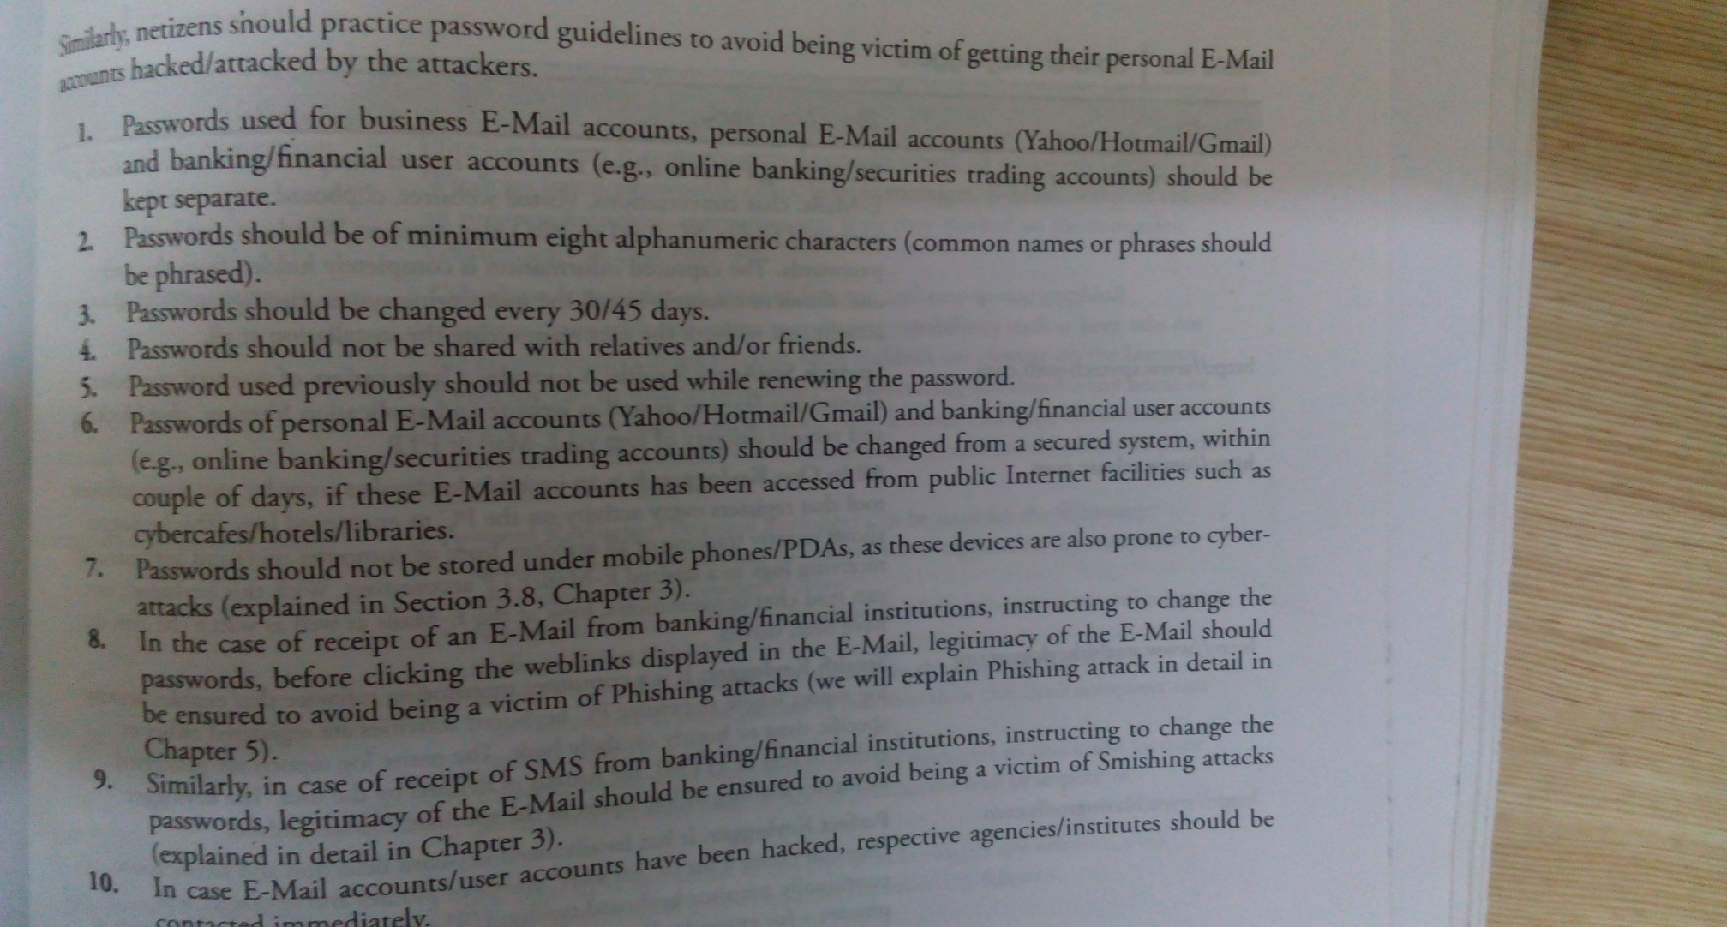
Cont…
The guidelines applicable to password policies for netizens:

Slide 17
Keyloggers and spywares
Keyloggers:
Key stroke logging often called keylogging ids the practice of noting the key struck on a key board, typically in a covert(secret) manner so that the person using the keyboard is unaware that such actions are being monitored.
It is a very easy and quick way to capture the Passwords.
It can be classified into two:
Software Keylogger
Hardware Keylogger

Slide 18
Cont…
S/w keyloggers:
s/w keyloggers are the programs installed on the computer systems which usually are located between the OS and the keyboard h/w.
They are installed on the system by trojans or viruses.
Cybercriminals always installs such tools on the insecure computer systems available in public places.
A keylogger usually consists of two files that get installed in the same directory : a DLL and an EXE file that installs the DLL file and triggers it to work.
DLL does all the recording of the keystrokes.
Eg. Stealth keylogger, KGB spy, spy buddy

Slide 19
Cont…
2. H/w keyloggres:
To install these keyloggers physical access to the computer is required.
h/w keyloggers are small h/w devices.
These are connected to PC and save every keystroke into a file or in the memory of the h/w device.
Cybercriminals install such devices in the ATM machines to capture ATM cards and PINs.
Each key press is registered by these loggers.
They look like an integrated part of the bank system hence usually ignored.

Slide 20
Cont…
Antikeylogger:
It is the tool that can detect the keylogger installed on the computer system and and also can remove the tool.
Advantage of it are:
Firewall cannot detect the installation of keyloggers which anti keyloggers can
It doesn’t require any updates key antivirus requires.
Prevents internet banking frauds.
It prevents ID theft.
It secures email and instant messaging.

Slide 21
Cont…
Spywares:
It is type of malware that is installed on the computers which collect information about users without the knowledge of users
It gets secretly installed on the user’s PC.
Spywares like keyloggers are installed by the owner of a shared corporate or public computer on purpose to secretly monitor the users.
The features and functions of such spywares are beyond simple monitoring.
It collects PI about users such as the internet surfing habits, and websites used.

Slide 22
Cont…
The spyware can also redirect internet surfing activities by installing another stealth utility.
It also may have the ability to change the computer settings, which may result in slowing of the internet connection speeds and response time.
Eg. 007 spy, spector pro, eblaster
There are anti spywares available today to control such things

Slide 23
Virus, worms and Trojan Horses
Virus:
Computer virus is a program that can infect legitimate programs by modifying them to include a possibly evolved copy of itself.
Viruses spread themselves without knowledge or permission of the users, to potentially large number of programs.
Viruses may also contain malicious info that may cause damage or annoyance
Viruses can spread without any readily visible symptoms.
A virus can start on event driven effects(triggered after a specific number of executions), time driven effects or can occur at random.

Slide 24
Cont…
Viruses can take some typical actions:
Display the message to prompt an action which may set of the virus.
Delete files inside the system into which viruses enter.
Scramble data on the hard disk.
Cause erratic screen behavior.
Halt the system
Just replicate themselves to propagate further harm.

Slide 25
Cont…
Computer virus has the ability to copy itself and infect the system.
A true virus can only spread from one system to another system when its host is taken to the target computer for instance when a user sent it over the internet or the n/w or carried it in a removable media.
Viruses can increase their chances of spreading to other systems by infecting files on a n/w file system that is accessed by another system.
The term computer virus is sometimes used as a catch all phrase to include all types of malware though they are different from worms and trojans.
A worm spreads automatically to other computers through n/w by exploiting vulnerabilities, where as trojan is a code program that appears to be harmless but hides malicious functions.
Worms and trojans may harm the systems data performance.

Slide 26
Cont…
Some viruses and other malware have noticeable symptoms that enable computer users to take necessary corrective action but many viruses simply do nothing to make users take any actions.
Some viruses do nothing beyond reproducing themselves.
eg,. Conficker, win32/agent etc.
Types of viruses:
Boot sector viruses:
Program viruses
Multipartite viruses
Stealth viruses
Polymorphic viruses
Macro viruses
Active X and Java control

Slide 27
Cont…
Boot sector viruses:
It infects the storage media on which OS is stored and which is used to start the computer system.
The entire programs are stored on the floppy disks and hard drives in smaller sections called sectors.
The first sector is called the Boot and it carries the master boot record(MBR).
MBR’s function is to read and load OS.
Hence if the virus infects the MBR, such floppy disk infect the victims hard drive when he reboots the system while the infected disk is in the drive.
Boot sector virus often spreads to other systems when such disks are shared or pirated s/w are used.

Slide 28
Cont…
2. Program viruses:
These viruses are active when the program file with extension .bin, .exe., .com, .drv etc is executed.
Once these program files gets infected the virus makes copies of itself and infects the other programs on the system.
3. Multipartite viruses:
It is a hybrid of boot sector and program viruses.
It infects program files along with the boot record.

Slide 29
Cont…
4. Stealth viruses:
It camouflages or masks itself so detecting this type of virus is very difficult even by antivirus s/w.
It alters its file size and conceals (hide) itself in the computer memory to remain in the system undetected.
The first computer virus known as brain was stealth virus.
A good antivirus detects a stealth virus lurking on the victim’s computer by checking the areas the virus must have infected by leaving evidence in memory.

Slide 30
Cont…
5. Polymorphic viruses:
It acts like chameleon that changes its virus signature very time it spreads through the system hence difficult to detect.
Polymorphic generators are the routines or programs that can be linked with the existing viruses.
Its purpose is to hide the actual viruses under the cloak (cover) of polymorphism.
Examples of generators are dark angel’s multiple encryptor, dark slayer mutation engine.

Slide 31
Cont…
6. Macro viruses:
Many applications such as MS word Excel support macros which are embedded in a document.
Macro virus infects very program created by the user.
This type of virus is relatively new and may not be detected.
7. Active X and Java control:
All the web browsers have settings about Active X and Java control.
A little knowledge of these settings can be very useful to enable or disable popups, downloading files and sounds etc.

Slide 32
Cont…
Worm:
A computer worm is a self replicating program.
It uses the network to send copies of itself to other computers on its own.
This is due to lack of security on target computers.
It doesn’t need a host program like a virus does.
It cause harm to the network by consuming bandwidth and resources.
Eg. Morris worm, Iloveyou, Melissa
Almost every day new worms and viruses are created and become new threat to netizens.

Slide 33
Cont…
Trojan Horses:
Trojan is a program in which malicious or harmful code is contained inside apparently harmless data in such a way it can get control and cause harm for eg ruining(corrupt) the file allocation table on the hard disk.
It can get into a system in a number of ways including from a web browser or with other software from internet.
It can also get through USB media.
Trojans do not replicate itself but are dangerous once infected.
For example waterfalls.scr is a screen saver but can be used as a Trojan.

Slide 34
Cont…
Examples of threats by tojans:
They erase, overwrite or corrupt data on a computer.
They help to spread other malware.
They deactivate or interfere with antivirus or firewall.
They allow remote access to your computer.
They upload and download file wthout your knowledge.
They gather email addresses and use them for spam.

Slide 35
Cont…
They log key strokes to steal info.
They copy fake links to false websites, display porno sites, play sounds and display images.
They slow down, restart or shut down the system
They reinstall themselves after being disabled.
They disable the task manager.
They disable the control panel.

Slide 36
Backdoor
What is Backdoor ?
A Backdoor is a means of access to a computer program that bypasses security mechanisms.
What is Backdoor virus ?
A Backdoor virus is a program that enters a computer system without being detected and runs in the background to open ports, allow in third parties to control the computer clandestinely.
These backdoor viruses can pass themselves off as legitimate programs.

Slide 37
What is Backdoor files?
A Network administrator [NA] may intentionally create or install a backdoor program for troubleshooting or other official use.
Hackers use backdoors to install malicious software file or programs, modify code or detect files and gain system and\or data access.

Slide 38
What a Backdoor Does?
It allow an Attacker To :--
Create, Delete, Rename, Copy or Edit any File.
Execute various commands
Change any system setting
alter the Windows registry
Run, Control and terminate application
install arbitrary software and parasites
It allow an Attacker to control computer hardware devices , modify related settings ,shutdown or restart a computer without asking for user permission.

Slide 39
It steals sensitive personal information , valuable documents , passwords , login names, ID Details ; logs user activity and tracks web browsing habits.
It records keystrokes that a user types on a computer’s keyboard and captures screenshots .
It sends all gathered data to a predefined E-Mail address, uploads it to a predetermined FTP server or transfers it through a background Internet connection to a remote host.
It infects files , corrupts installed applications and damages the entire system.

Slide 40
It distributed infected files to remote computers with certain security vulnerabilities and performs attacks against hacker-defined remote hosts.
It installs hidden FTP server that can be used by malicious persons for various illegal purposes.
It degrades Internet connection speed and overall system performance , decreases system security and causes software instability . some parasites are badly programmed as they wast too many computer resources and conflict with installed applications.
It provides no uninstall features and hides process , files and other objects to complicate its removal as much as possible.

Slide 41
Examples of backdoor Trojans :
Back Orifice :
It is well-known example of backdoor Trojan designed for remote system administration.
It Enables a user to control a computer running the Microsoft Windows OS from a remote location.
The name is word play on Microsoft BackOffice server software.
Bifrost :
It is another backdoor Trojan that can infect Windows 95 through Vista.
It uses the typical server , server builder and client backdoor program configuration to allow a remote attacker , who uses client , to execute arbitrary code on the compromised machine.

Slide 42
How to protect from Trojan Horse & Backdoor
Follow the following steps to protect your systems from Trojan horses and backdoors :
1. Stay away from suspect websites/web links :
Avoid downloading free/pirated softwares that often get infected by Trojans , worms , viruses and other things.
We have addressed “how to determine a legitimate website”.
2. Surf on the Web cautiously :
Avoid connecting with and/or downloading any information from peer-to-peer(P2P)networks , which are most dangerous networks to spread Trojan Horses and other threats.
P2P networks create files packed with malicious software and then rename them to files with the criteria of common search that are used while surfing the information on the Web.

Slide 43
It may be experienced that , after downloading the file, it never works and here is the threat that – although the file has not worked , something must have happened to the system – the malicious software deploys its gizmos and the system is at serious health risk.
Enabling spam filter “ON” is a good practice but it is not 100% foolproof , as spammers are constantly developing new ways to get through such filters.
3. Install antivirus/Trojan remover software :
Nowadays antivirus software built-in feature for protecting the protecting the system not only from viruses and worms but also from malware such as Trojan Horses.
Free Trojan remover programs are also available on the Web and some of hem are really good.

